Slide 1
Introduction
Heart rate monitoring is an important component especially in cardiovascular fitness assessment and training programmes. It can be done in two ways:
1)Electrocardiography 2) Using sensor
In this project we have designed a heart rate monitoring system using arduino and heartbeat sensor.
The objective of this project is to count heartbeat of a human body in 10 sec and display it in 16*2 LCD in BPM.
It will also detect abnormal condition of heart rate using buzzer.

Slide 2
Components
Arduino Uno
16x2 LCD Display
Heart Beat Sensor Module with Probe (Finger Based clip)
10k Ω Potentiometer
Push Button
5V Buzzer
Breadboard
Connecting Wires

Slide 3
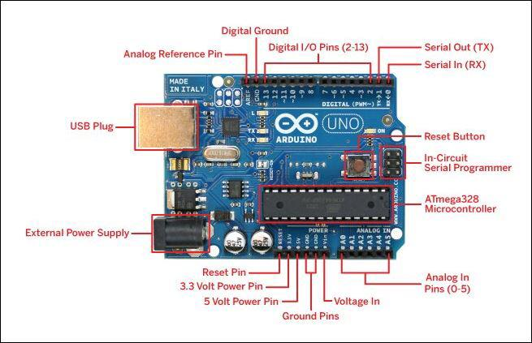
Arduino uno is a microcontroller board based on 8-bit ATmega328P microcontroller.
It consists other components such as crystal oscillator, serial communication, voltage regulator, etc. to support the microcontroller.
It has 28 pins, 6 analog pins (A0-A5), 14 digital pins (0-13) in this 6 pins are used as PWM outputs, reset pin, power pins (Vin, 3.3V, 5V, 2 Analog ground pins),digital ground pin, analog reference pin.
It also has a USB connection, A Power barrel jack, an ICSP header and a reset button.
Arduino UNO

Slide 4
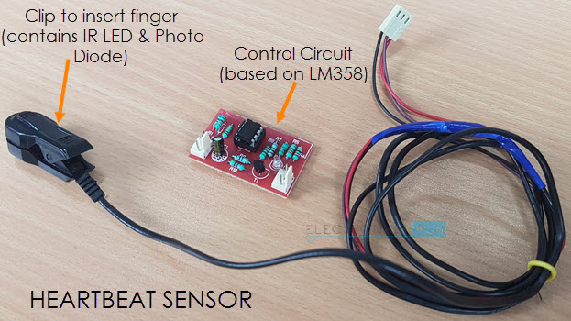
Heart Beat Sensor module consists of a sensor and control circuit.
Sensor has an IR LED and a photodiode placed in a clip.
Control Circuit consists of an IC LM358 and few other components that help in connecting the signal to the microcontroller.
Heart Beat Sensor

Slide 5
10k Ω Potentiometer:
Potentiometer is used to adjust brightness of LCD Display.
Push Button:
Push Button is used to start the measurement of heart beat.
5V Buzzer:
Buzzer is used to alert the people when abnormal heart beat of a person occurs.
LCD Display:
An LCD is an electronic display module that uses liquid crystal to produce a visible image.
LCD16x2 has 2 lines with 16 characters in each line. Each character is made up of 5x8 (column x row) pixel matrix. It has 16 pins in total.

Slide 6
Working
The principle is that the changes in the volume of blood in an organ is measured by the changes in the intensity of the light passing through that organ.
A simple Heartbeat sensor consists of a sensor and a control circuit. The sensor part of the Heartbeat sensor of an IR LED and a Photodiode placed in a clip.
The control circuits consists of 2 Op-Amps one acts as Inverting Amplifier & other one as comparator, circuit also consists a transistor from which signal is given to microcontroller.
Every heartbeat will alter the amount of light received by photodiode and output of photodiode is given to non inverting input of 1st Op-Amp through capacitor which blocks the DC component in signal. Output from 1st Op-Amp is given to 2nd Op-Amp i.e. comparator, output of comparator triggers the transistor from which signal is given to microcontroller i.e. Arduino.

Slide 7
Block Diagram
HEARTBEAT SENSOR
CONTROL CIRCUIT
Unregulated pulse
signal
Regulated pulse signal
COMPUTER/ LAPTOP
ARDUINO UNO
16*2 LCD HEARTBEAT IN BPM
Program
Digital
signal
BUZZER

Slide 8
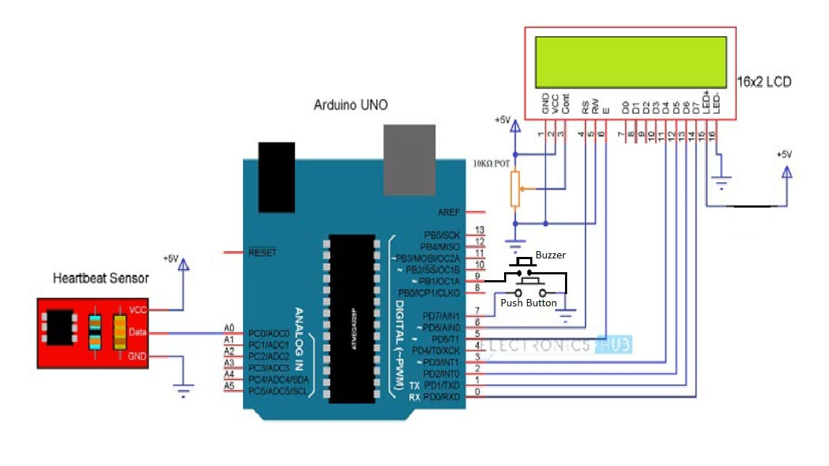
Circuit Diagram:

Slide 9
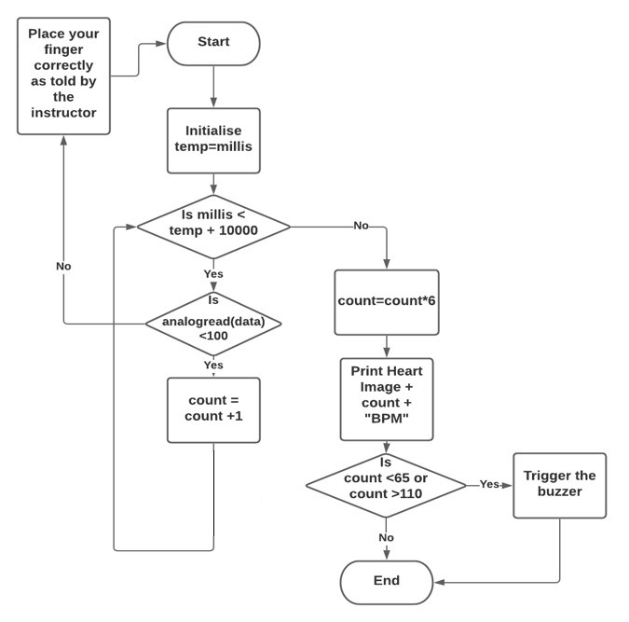
Code Flowchart:

Slide 10
Project Working Video:
https://drive.google.com/file/d/191QKumX_-c7S29U-c0Rm-vkpW4wqjy5b/view?usp=sharing

Slide 11
Advancements
Detects the abnormal heart beat of a person using heart beat and sends the message automatically to doctor or ambulance and alerting family members.
For continuously monitoring the patient’s heart beat each and every minute so that the patient’s condition who are in ICU’s can be immediately informed to doctors.
Sleep monitoring.

Slide 12
Conclusion
In this project we have measured BPM of a patient using Arduino Uno and a Heartbeat sensor.
Measurement of heartbeats is solely done by placing a finger in clip which works on the amount of light received by the photodiode presents in a circuit hence the chance patient getting hurt is approximately zero.
BPM of a healthy person in found to be between 60 to 100 beats per minute while doing exercise BPM may rise upto 130 to 150 beats per minute.
Using the above point we have set the buzzer to trigger if BPM of person rises above 110 or falls below 65, buzzer will sound and the patient or doctor should act accordingly.

Slide 13
References
Souvik Das “The Development of a Microcontroller Based Low Cost Heart Rate Counter for Health Care Systems” International Journal of Engineering Trends and Technology- Volume 4 Issue 2- 2013.
Embedded Lab. Introducing Easy Pulse: A DIY photoplethysmographic sensor for measuring heart rate. http://embedded-lab.com/blog/?p=5508, 2012.
Embedded Lab. PC-based heart rate monitor using Arduino and Easy Pulse sensor. http://embedded-lab.com/blog/?p=7485 , 2013.
Embedded Lab”Arduino measures heart beat rate from fingertip”

Slide 14
Thank You!

